Slide 1
Conditional Behavior Trees Definition, Executability, and Applications
Eleonora Giunchiglia
Michele Colledanchise
Lorenzo
Natale
Armando Tacchella

Slide 2
IDEA
enable monitoring the execution of single actions by checking pre- and post-conditions.
CONTRIBUTIONS
1：a definition of CBTs, an extension of BTs that enables expressing pre- and post-conditions for actions
2： a methodology to statically check CBTs to ensure their executability
3：a tool based on off-the-shelf SAT solvers【 encode a CBT executability problem into a propositional satisfiability (SAT) problem 】

Slide 3
Conditional Behavior Tree
Two sets：
1： the set of actions A that a robot may perform
Every action node a∈ A is decorated by a couple (Pre_{a}, Post_{a}), both Pre_{a} and Post_{a} are subsets of F
2： the set of fluents F (propositions about the robot and the environment that might hold or not depending on the current state)
Two assumption：
1： if the action node is ticked at some time instant t∈ N, the corresponding action
is always over at time instant t + 1
2： only action nodes as children in parallel nodes

Slide 4
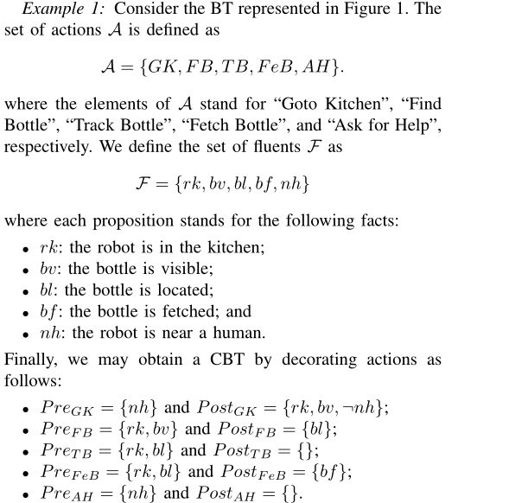
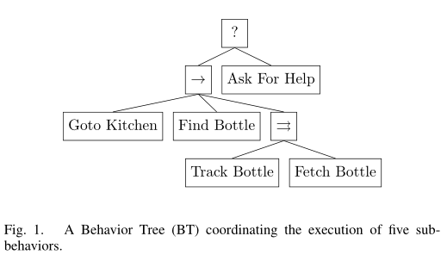
Conditional Behavior Tree
Example

Slide 5
Conditional Behavior Tree
Others：
a_{t}： Given an action a ∈ A and some time instant t ∈ N, we write a_{t} (resp. ˜a_{t}) to denote that action a is ticked at time t and succeeds (resp. fails) at time t + 1
σ_{T}： Given a CBT T , we define an action instantiation sequence of T , denoted as σ_{T} = <u_{t0} , u_{t1} , u_{t2} , . . .>, u_{t} = a_{t} or u_{t} =˜a_{t}
Σ_{T}： The set of all such sequences for a CBT T is denoted as Σ_{T} in the following σ_{T}∈Σ_{T}
<GK₀, FB₁, TB₂, FeB₂>
<~GK₀, AH₁>
<AH₀>
<GK₀, AH₁ >

Slide 6

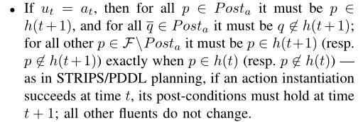
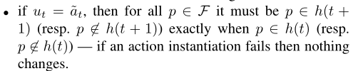
Conditional Behavior Tree
take into account pre- and post-conditions：
history： N→ 2^{F} , after t ticks have been generated, h(t) is the set of fluents that hold at such point in time.
h(t) |= a： for all fluents p∈ F such that p∈ Pre_{a}, it is also the case that p∈ h(t). Intuitively, an action is executable in state h(t) exactly when its pre-conditions hold in that state.
h(t) |= u_{t}： ut = a_{t} or ut =˜a_{t} for some action a∈ A as long as a is executable in state h(t)
Given a CBT T , we say that a history h supports an action instantiation sequence σ_{T} = {u_{t0} , u_{t1} , u_{t2} , . . .}, denoted with h |=σ_{T} , exactly when for all u_{t}∈σ_{T} :
A CBT T is executable exactly when, for all action instantiation sequences σ_{T}∈Σ_{T} , there exists h such that h |= σ_{T} .

Slide 7
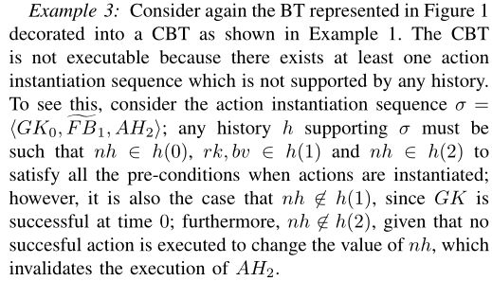
Conditional Behavior Tree
Example

Slide 8
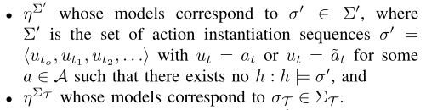

Encoding Executability
Two propositional logic formulas：

Slide 9
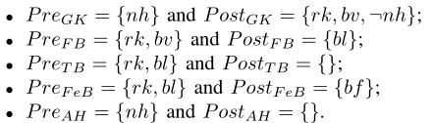
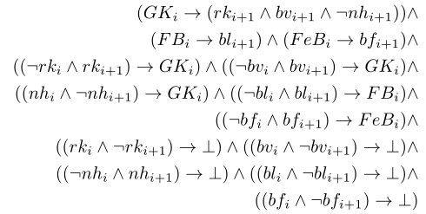
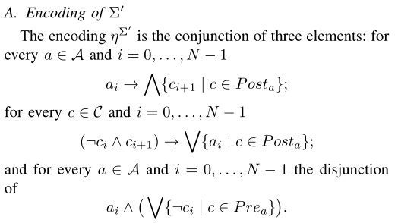
Encoding Executability
Example

Slide 10
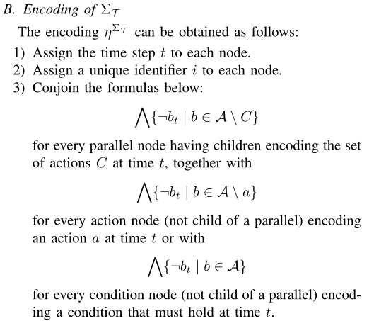
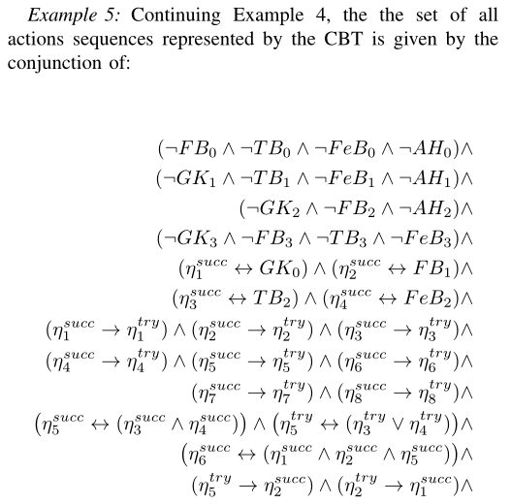
Encoding Executability
Example

Slide 11
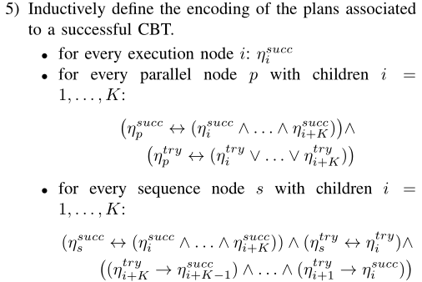
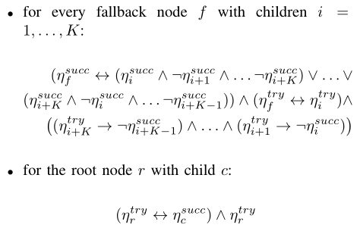
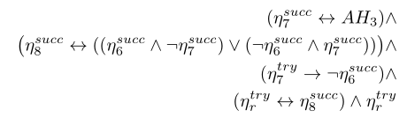
Encoding Executability
Example

Slide 12
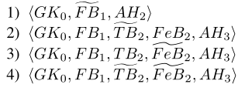
Encoding Executability
Example

